Slide 1
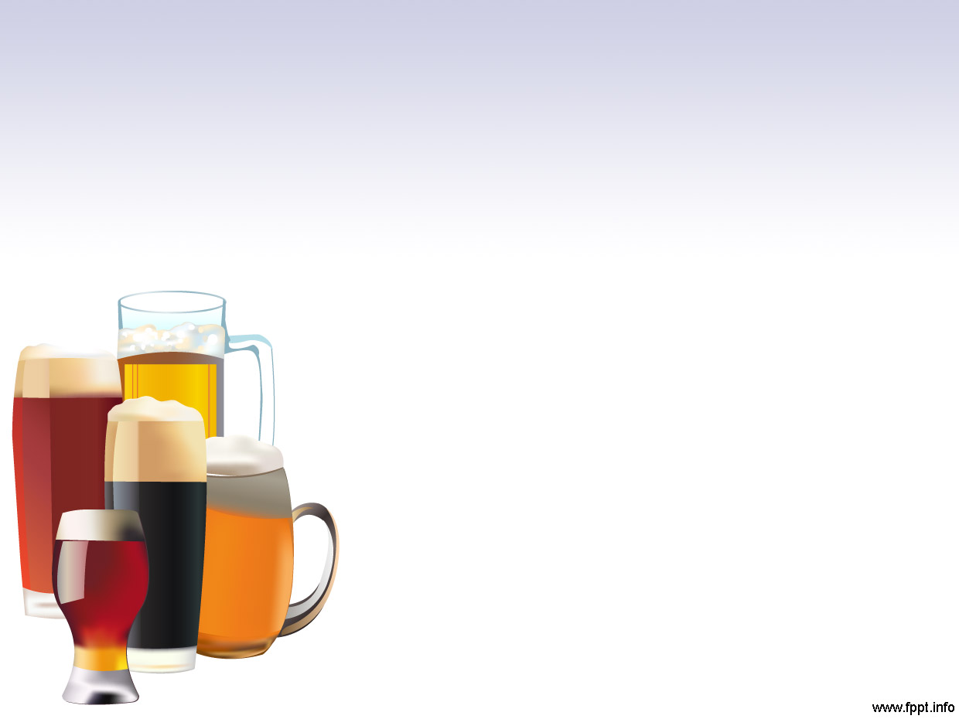
Exploratory Data Analysis of Breweries and Beer
Prepared for Brendan Whitworth, CEO, and Fernando Tennenbaum, CFO, of Anheuser Busch In Bev
By-Jason Mcdonald And Ranjan Karki

Slide 2
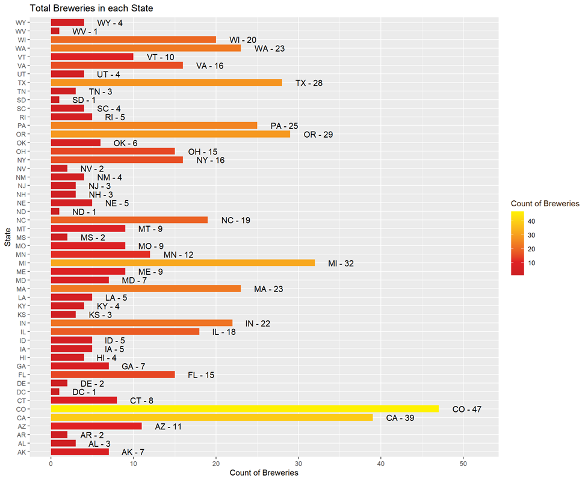
Breweries Per State

Slide 3
Missing values

Slide 4
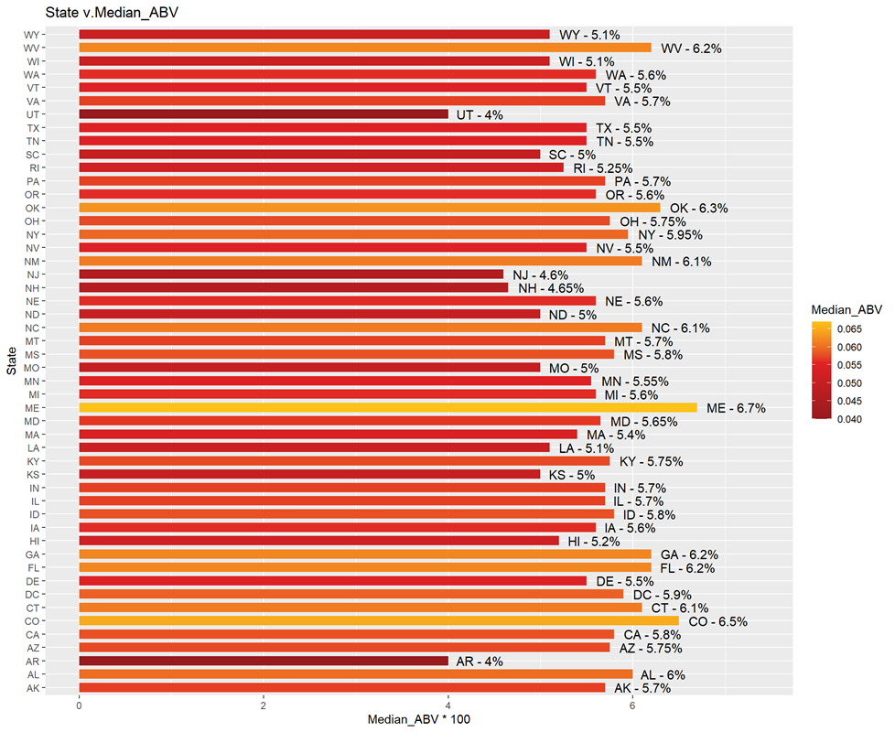
ABV by State
Notes:
To identify the median ABV and IBU by state, we performed a calculation on the dataset, grouping by state and finding the mediam in each. We then generated barplots as seen here.

Slide 5
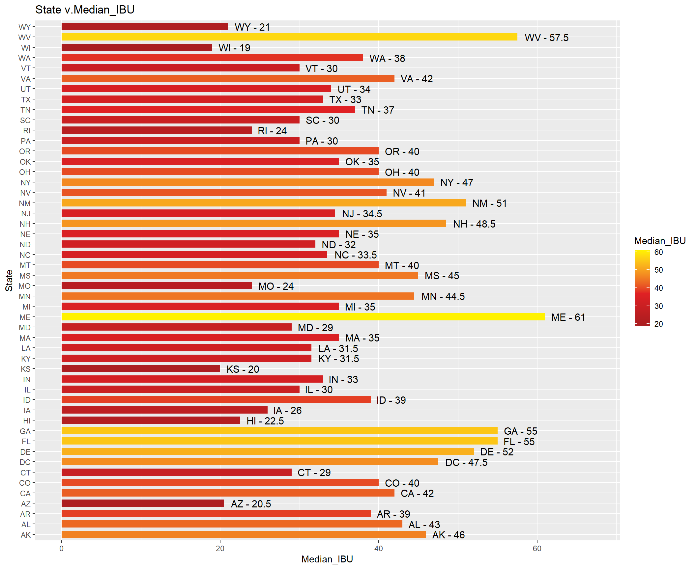
IBU by State
Notes:
And then, IBU by State.

Slide 6
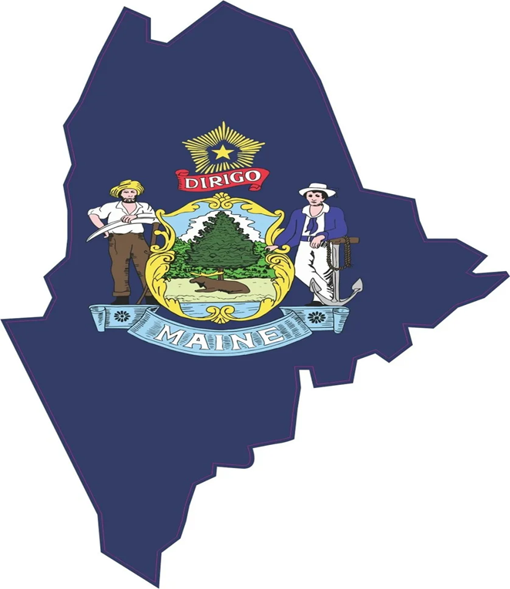
Max ABV and Most IBU
Notes:
You had asked which state had the maximum alcoholic beer and which state had the most bitter beer.
We’ve found that Maine actually holds that title for both categories.

Slide 7

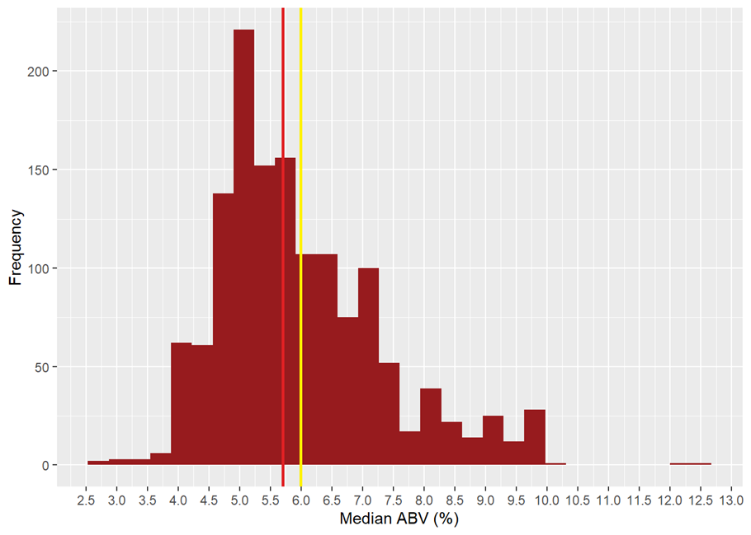
ABV Summary
Mean | SD
5.99 | 1.35
Notes:
In analyzing the alcohol content of the craft beers, we see a roughly normal distribution along the median with the mean, represented in red, and median, in yellow, falling close to each other. We do some outliers such as the max ABV of 12.5, more than double the mean. On the low side, we as well see a small number with a low ABV.

Slide 8
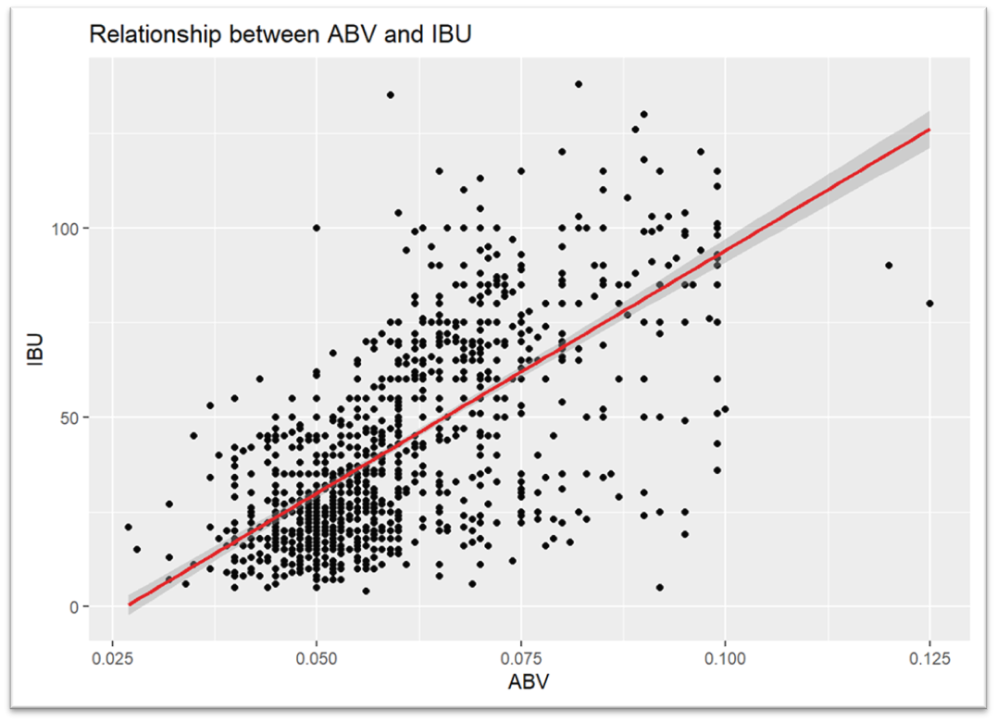
ABV vs IBU
Notes:
## Question 7: Is there an apparent relationship between the bitterness of the beer and its alcoholic content? Draw a scatter plot. Make your best judgment of a relationship and EXPLAIN your answer.
### While there appears to be some positive relationship between ABV and IBU, it appears to be somewhat weak. There are numerous outliers, specifically those with a high ABV but low IBU, that don't fit well within that explanation. This isn't unexpected upon additional review of the data, as seen below, as IPAs are known for their bitterness and higher alcohol content.

Slide 9
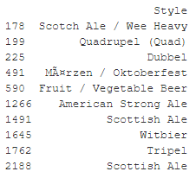
ABV vs IBU
Notes:
Taking a look at what type of beers have the highest ABV while the lowest IBU shows that that group consists primarily with beers you would expect to find lower IBUs such as Ales and Witbeer

